Slide 1

Mass Shooting
in USA
Haoran, Jingnan & Zahra

Slide 2
CONTENT
+
Introduction
+
Research Question
+
Data Description
+
Preliminary Visualization
+
Way Forward

Slide 3
Introduction
“
On February 14, 2018, a mass shooting occurred at Marjory Stoneman Douglas High School in Parkland, Florida. Seventeen people were killed and fourteen more injured.
In Texas, Governor Greg Abbott passed the 84th Texas Legislature on gun law which permits handgun license holders to carry their weapons onto the campus and buildings of public universities and colleges in Texas.
Coming from countries where an ordinary person cannot carry gun(s), these were surprising facts for us. Hence, we would like to find more facts about mass shooting in the United States.
“

Slide 4
Introduction
All about FACTS,
Nothing POLITICS.

Slide 5
Research Question
Trend
Characteristics
Policy
What is the trend for mass shooting accidents?
What is the trend for casualties? Injured?
What are demographic characteristics for shooters?
What drives them to mass shootings?
Is mass shooting associated with stated gun policy?
Other possible factors?

Slide 6
Data Description
Stanford Mass Shootings of America (MSA)
Introduction of MSA
It is a public accessible dataset of spatial and temporal data about mass shootings in America.
Information collection is fulfilled by Stanford Geospatial Center.
Definition
3 or more shooting victims, not including the shooter.
The shooting must not be identifiably gang, drug, or organized crime related.
Data Collection
The information collected is limited to online resources.
It covers the existing online reports of mass shooting from 1966 to 2017.

Slide 7
Data Description
Stanford Mass Shootings of America (MSA)
Event : title, location, city, state, latitude, longitude
Victims : number of fatalities, number of injured, total victims
Shooters : age, gender, race, employment, mental status
Motivation : target, cause,

Slide 8
Data Description
Stanford Mass Shootings of America (MSA)
Shortcomings in present Data
Incomplete data collection
(multiple confirmation > comprehensiveness)
Selection bias in data collection/generation process
(online report; personnel change; classification)
Missing values from incomplete case
(missing cases of unidentified/ undisclosed
offenders)

Slide 9
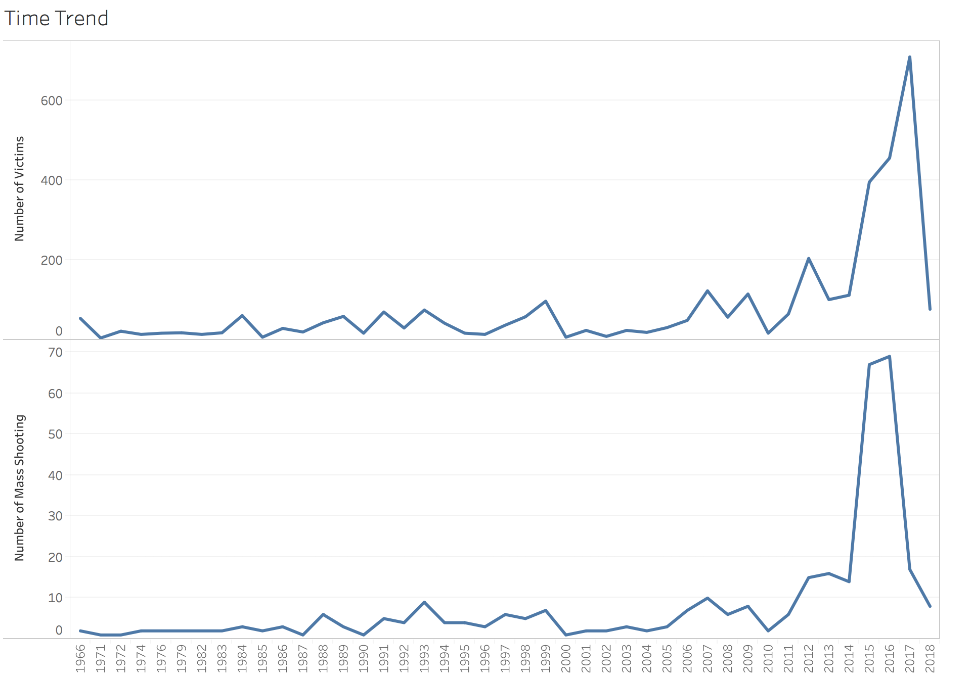
Visualization

Slide 10
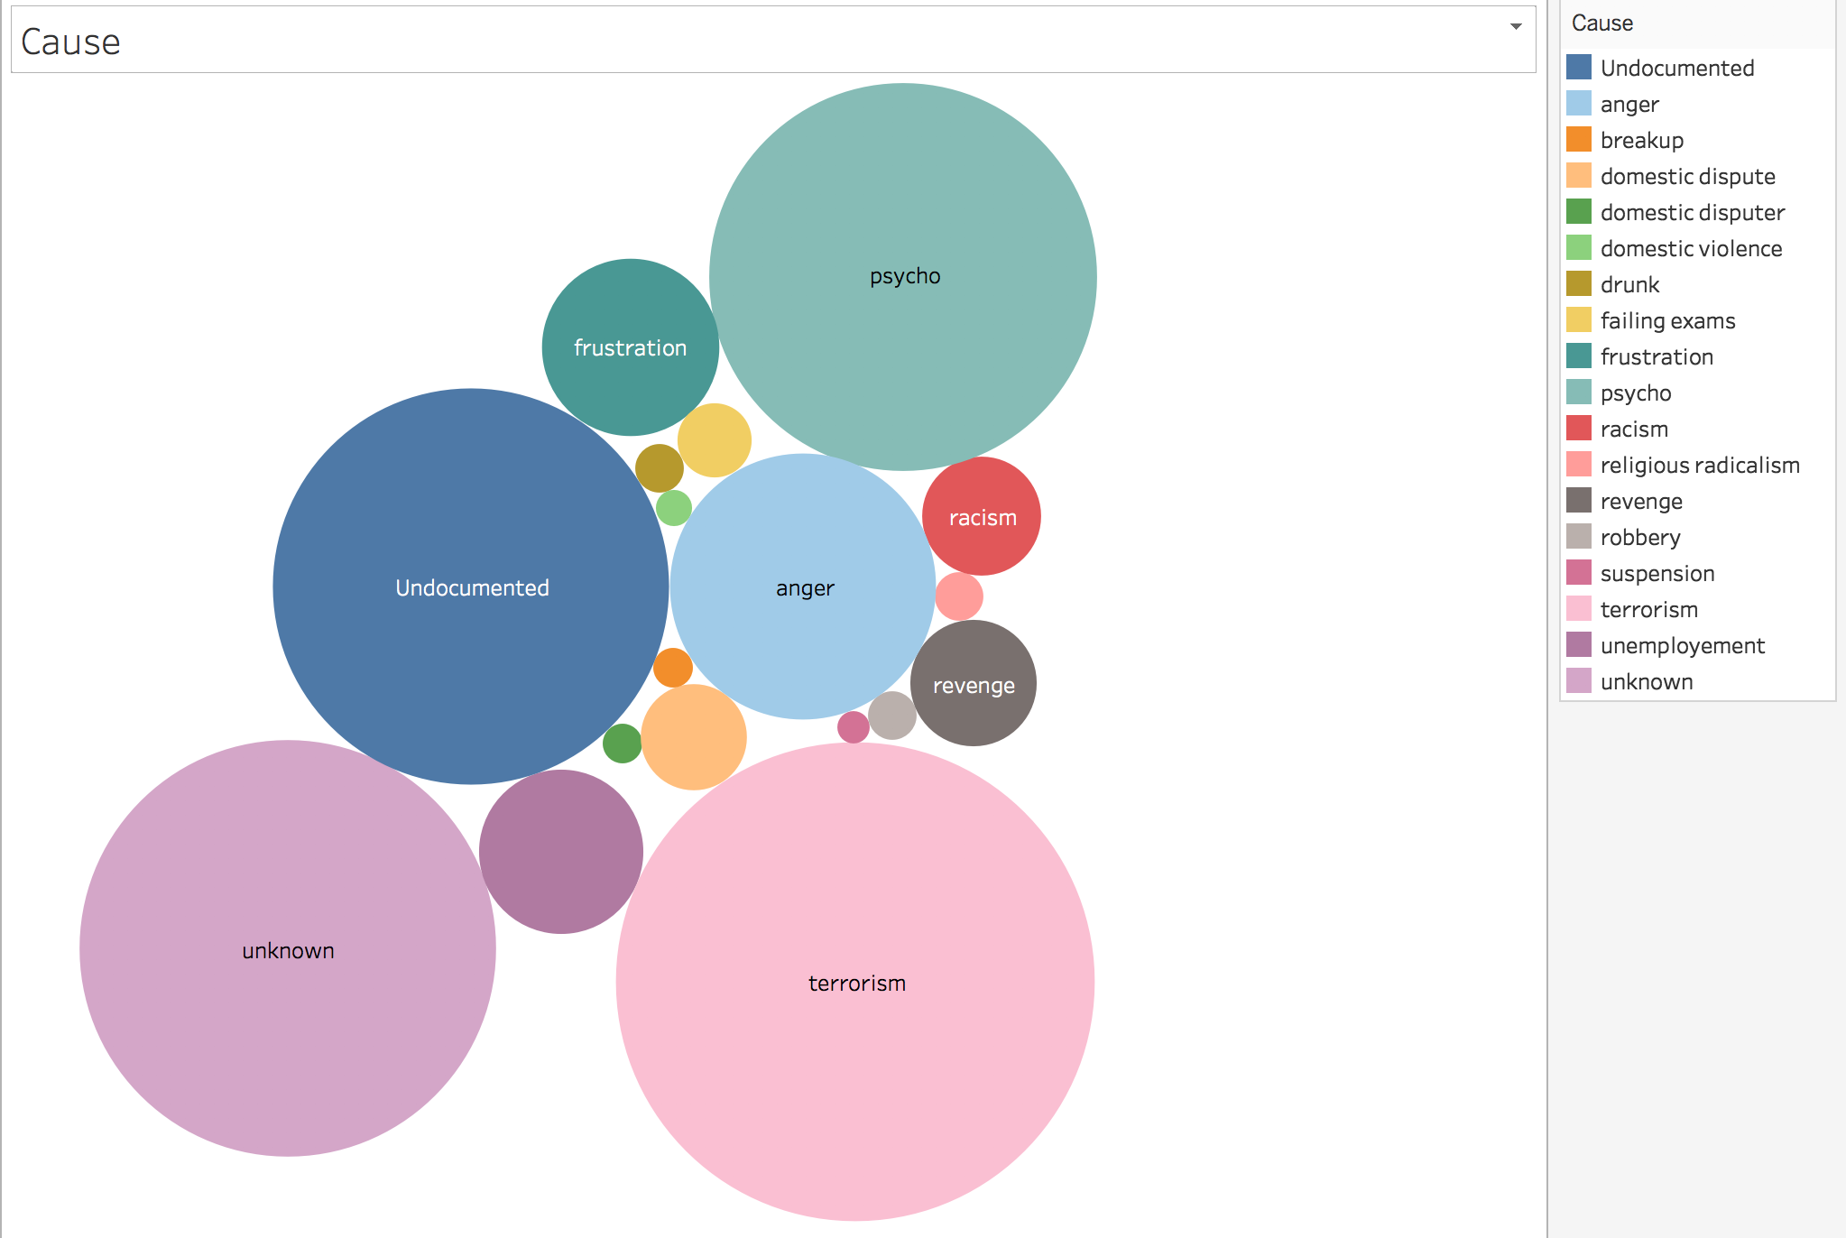
Visualization

Slide 11
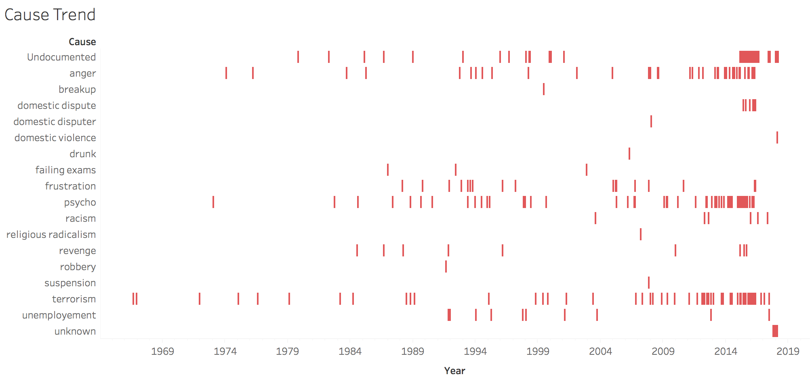
Visualization

Slide 12
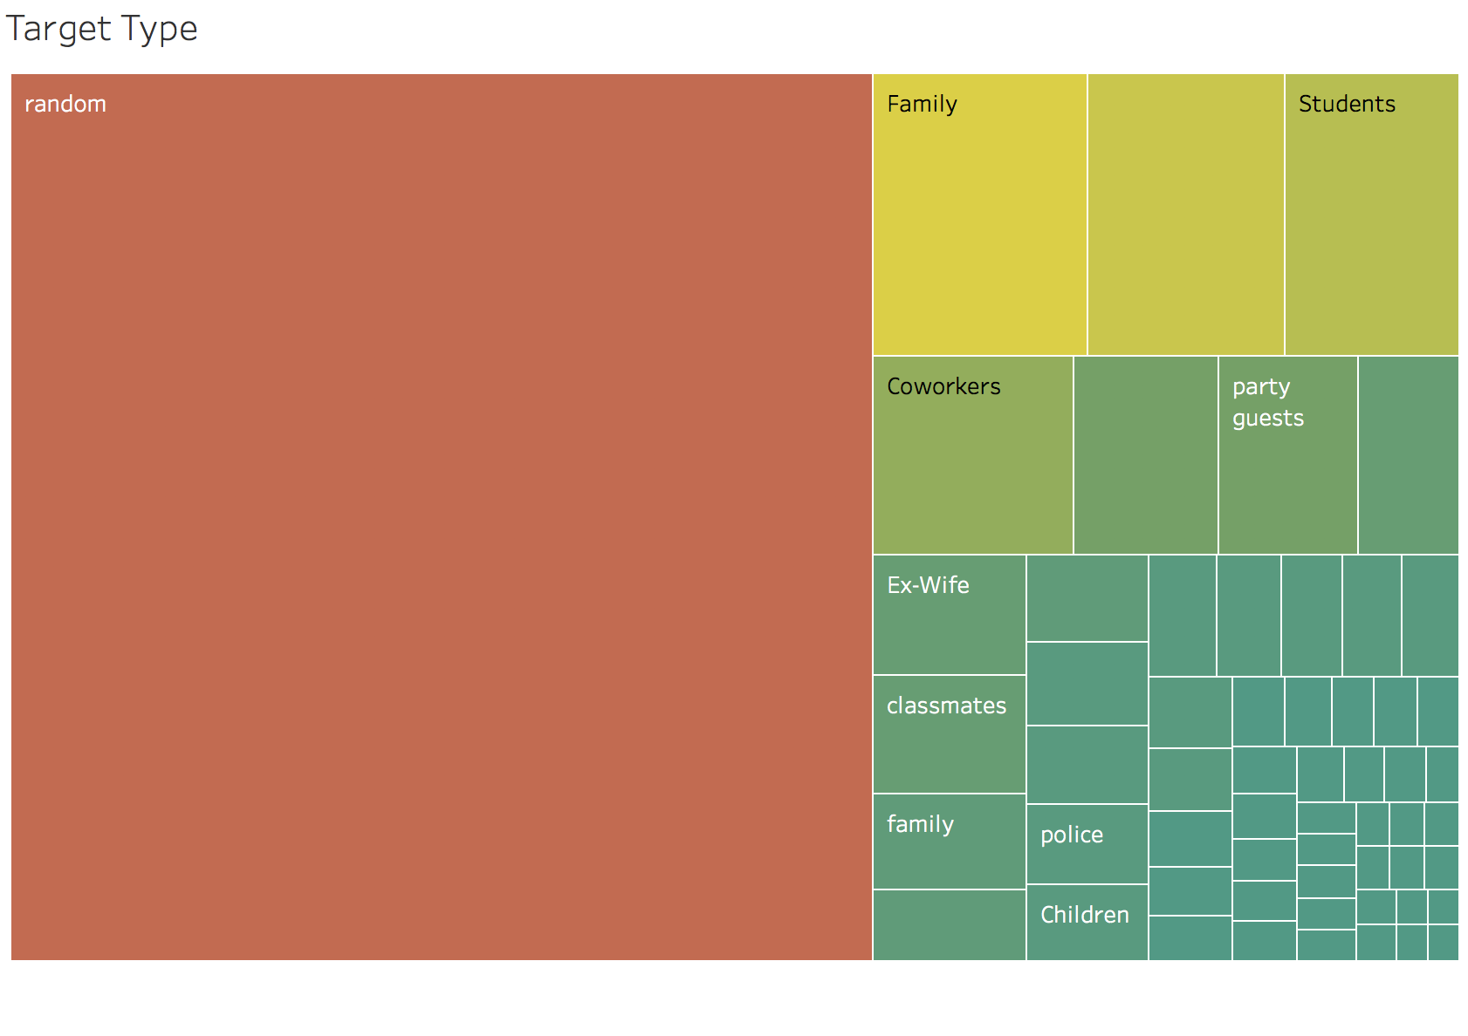
Visualization

Slide 13
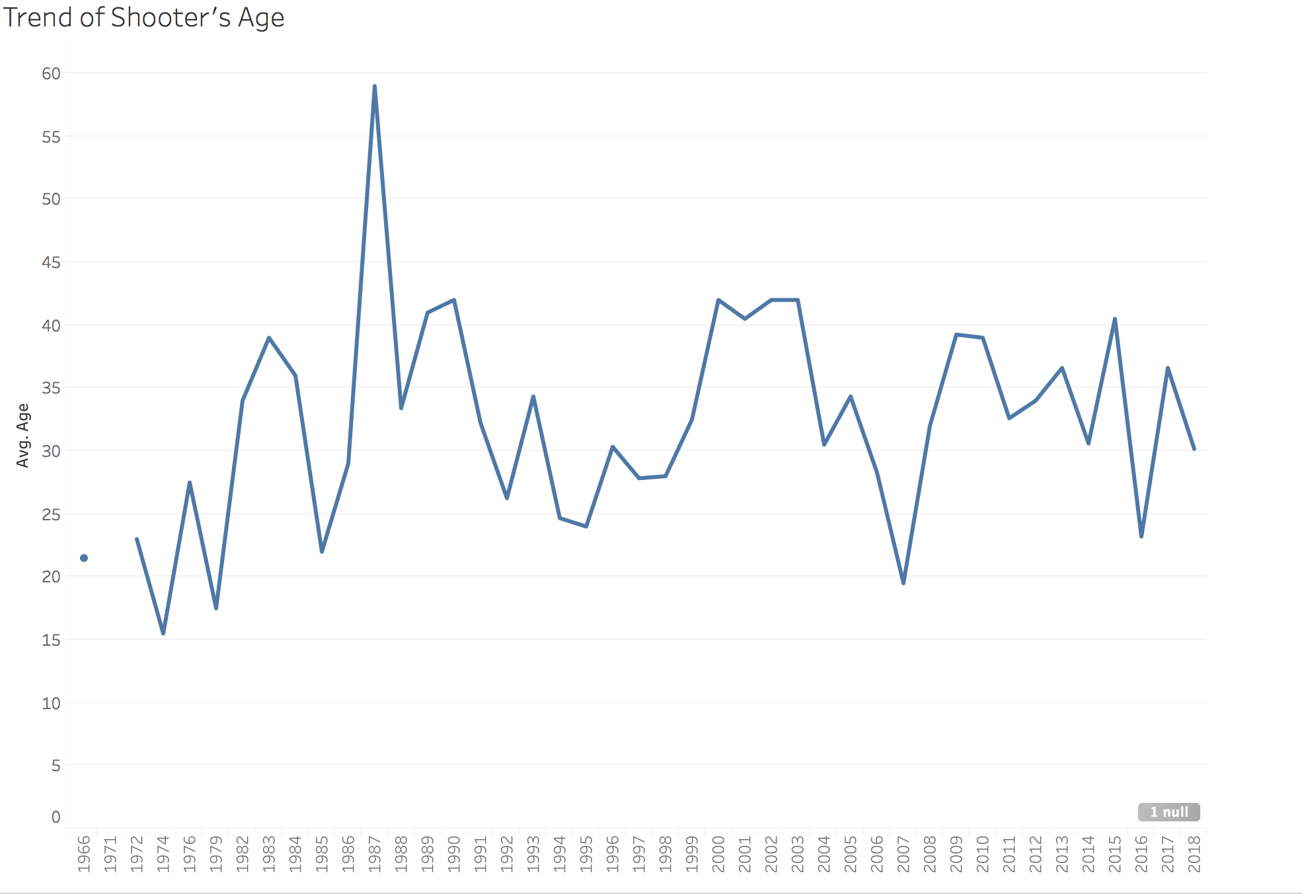
Visualization

Slide 14
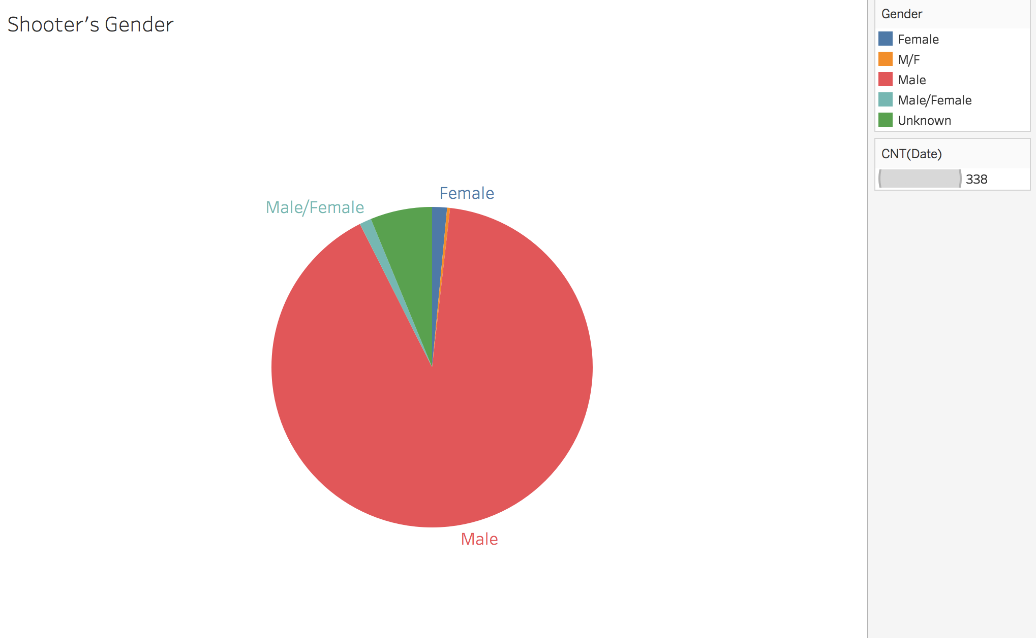
Visualization

Slide 15
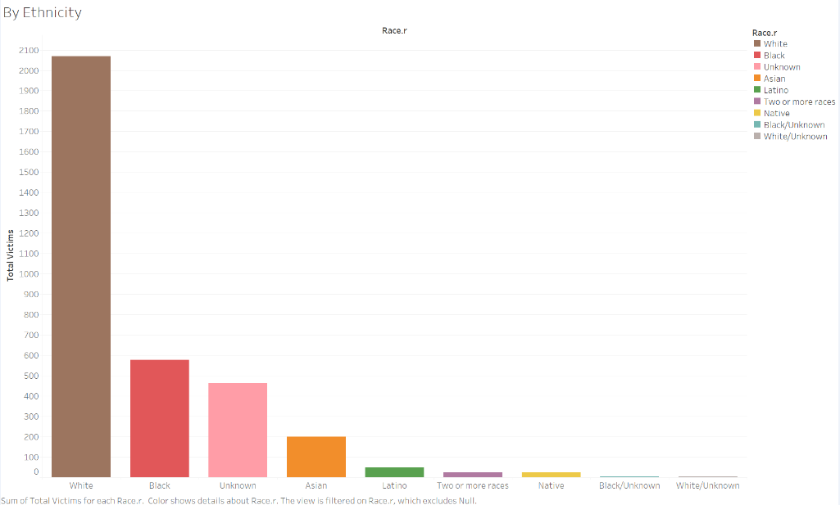
Visualization

Slide 16
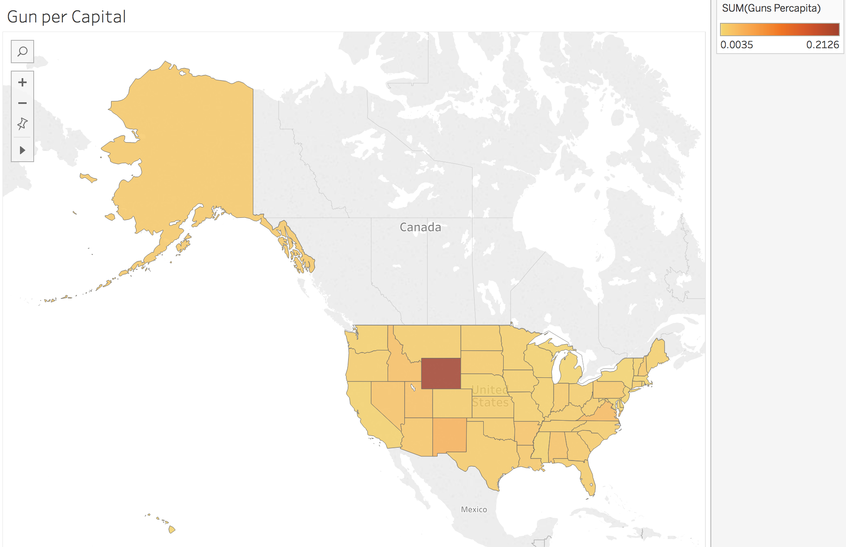
Visualization

Slide 17
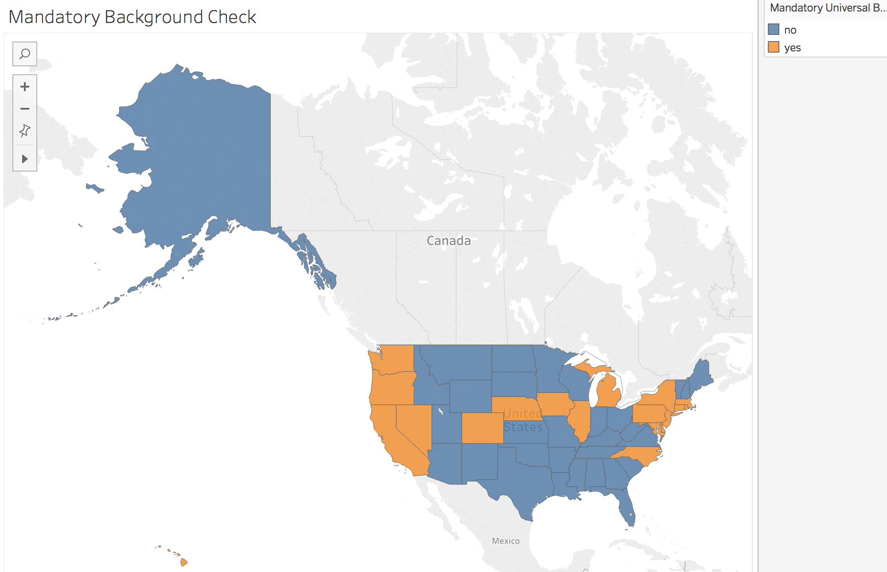
Visualization

Slide 18
Way Forward
Further clean the data
Conduct more insightful data analyses
1
2
3
4
Complete the full story about mass shooting in USA.
Update gun policy information

Slide 19
THANKS
Questions?

